Slide 1
D.C. Circuits ( Direct Current)
Applications: Majority are Electronic equipment like
cell phones, computers, radios
Basic block – Circuit
Sources: Voltage and Current
Components in circuit – Resistors

Slide 23
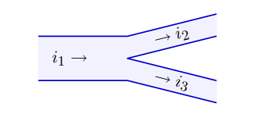

Kirchoff’s current law(KCL)
$i_{1}=i_{2}+i_{3}$

